Slide 1
Recommender Systems
CSE 303 Machine Learning
Krishna Sharma
AP22110010128
CSE O

Slide 2
Introduction to Recommender Systems
A recommender system is a type of information filtering system that suggests items (like products, movies, articles, etc.) to a user based on their preferences, interests, and past behavior. They make personalized recommendations, helping users discover new things they might like.
Two Main Types:
Content-Based Filtering
How it works: Analyzes the characteristics of items a user has interacted with (e.g., genres, keywords, actors for movies) to find similar items.
Example: If you've watched a lot of sci-fi movies, it might recommend other sci-fi movies.
Collaborative Filtering
How it works: Identifies users with similar tastes and recommends items that those similar users liked.
Example: If users who liked the same movies as you also liked "Star Wars," it might recommend "Star Wars" to you.

Slide 3
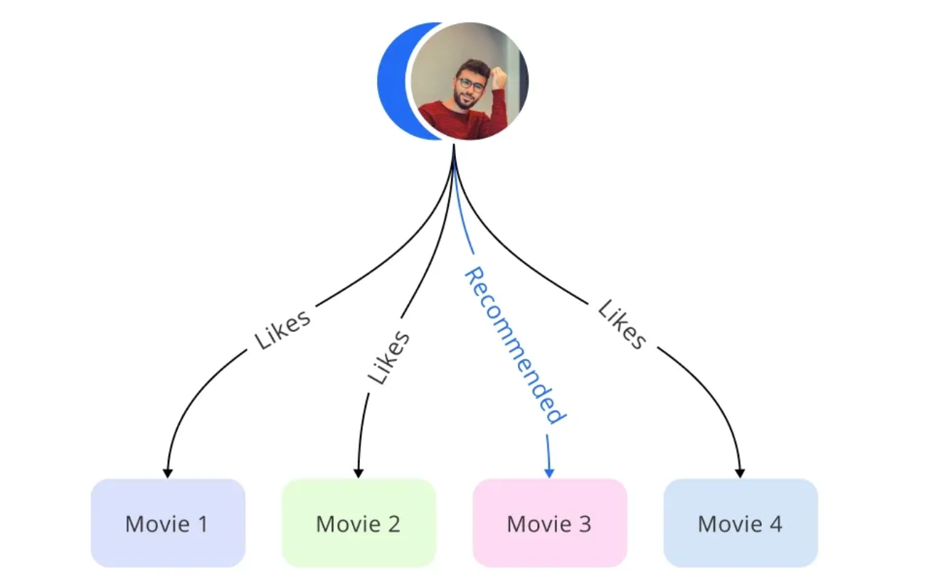
Content-Based Filtering
Content-based filtering recommends items similar to what you've liked before. It analyzes the content of items you've interacted with (e.g., movies you've watched) and suggests items with similar features (like genre, director, or plot).
Advantages of Content-Based Filtering:
Personalization
No Cold Start Problem
Explainability
Limitations of Content-Based Filtering:
Limited Diversity
Overspecialization

Slide 4
Techniques in Content-Based Filtering
Text-Based Techniques:
Term Frequency-Inverse Document Frequency (TF-IDF): Assigns weights to terms in a document based on their importance. It helps identify the most relevant terms for a given item.
Similarity Measures:
Cosine Similarity: Measures the similarity between two documents by calculating the cosine of the angle between their vector representations.
Machine Learning Techniques:
Naive Bayes: A probabilistic classifier that assumes independence between features. It can be used to classify items into categories based on their content.
Decision Trees: A tree-like model of decisions and their possible consequences. They can be used to classify items or predict user preferences based on their features.

Slide 5
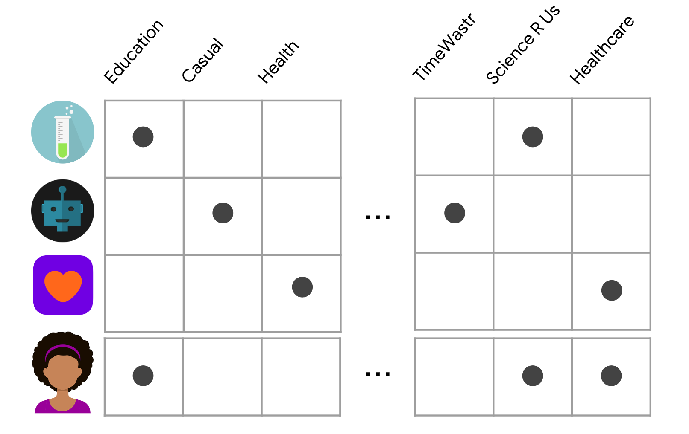
Examples of Content-Based Filtering
Movie Recommendation:
User: Watches "Inception" (Sci-Fi, Thriller, Mystery)
Recommendation: "Interstellar" (Sci-Fi, Adventure, Drama) - Similar genres and themes.
Article Recommendation:
User: Reads articles tagged "Artificial Intelligence," "Machine Learning," and "Data Science“
Recommendation: Articles with similar tags or keywords like "Deep Learning," "Neural Networks," or "Natural Language Processing.“
Product Recommendation:
User: Purchases a pair of blue jeans
Recommendation: Other blue jeans, jeans in similar styles or brands, or other denim products like jackets.

Slide 6
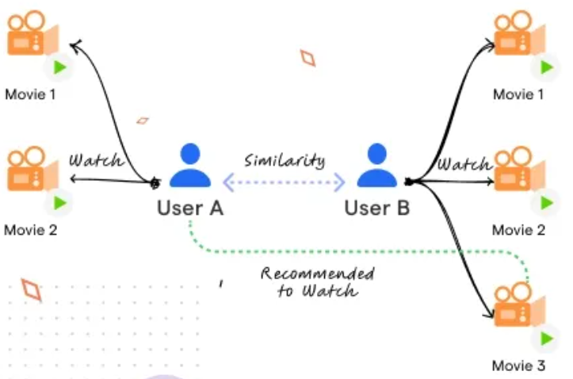
Collaborative Filtering
Collaborative filtering is a technique that leverages user interaction data to recommend items. It operates on the principle that if two users have similar tastes, they will likely enjoy similar items.
Key Concepts:
User Interaction Data: This includes information about how users have interacted with items, such as ratings, purchases, or clicks.
Similar Users: Users with similar preferences or behaviors are identified.
Recommendation: Items that similar users have liked but the target user hasn't are recommended.
For example, if you often watch sci-fi movies and have rated them highly, a collaborative filtering system might recommend other sci-fi movies that users with similar preferences have enjoyed.

Slide 7
Techniques in Collaborative Filtering
Memory-Based Methods:
User-Based Collaborative Filtering: Finds users with similar preferences to the target user. Recommends items that similar users have liked.
Item-Based Collaborative Filtering: Finds items similar to items the target user has liked. Recommends similar items to the user.
Model-Based Methods:
Matrix Factorization: Decomposes the user-item rating matrix into lower-dimensional matrices, representing latent factors. Predicts missing ratings based on these latent factors.
Singular Value Decomposition (SVD): A specific type of matrix factorization that decomposes the rating matrix into three matrices: user-latent factor, latent factor-item, and singular values. Can be used to predict missing ratings and make recommendations.

Slide 8
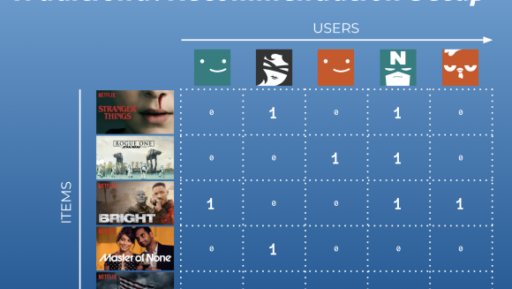
Examples of Collaborative Filtering
Amazon's Recommendation System: If you've purchased a lot of sci-fi books, Amazon might recommend other sci-fi books, even if you haven't specifically searched for them.
Netflix's Recommendation System: If you've watched a lot of crime dramas, Netflix might recommend other crime dramas or thrillers.
Spotify's Recommendation System: If you frequently listen to indie rock, Spotify might recommend other indie rock bands or artists with a similar sound.

Slide 9

Case Study - Spotify’s Recommender System
Spotify's recommendation system is a complex interplay of various techniques, including collaborative filtering and content-based filtering, that work together to deliver highly personalized music recommendations.
Key Components of Spotify's Recommendation System:
Collaborative Filtering:
Content-Based Filtering:
Hybrid Approach:
Contextual Bandits:
Machine Learning:
By combining these techniques, Spotify's recommendation system aims to provide a seamless and personalized music listening experience for its users.

Slide 10
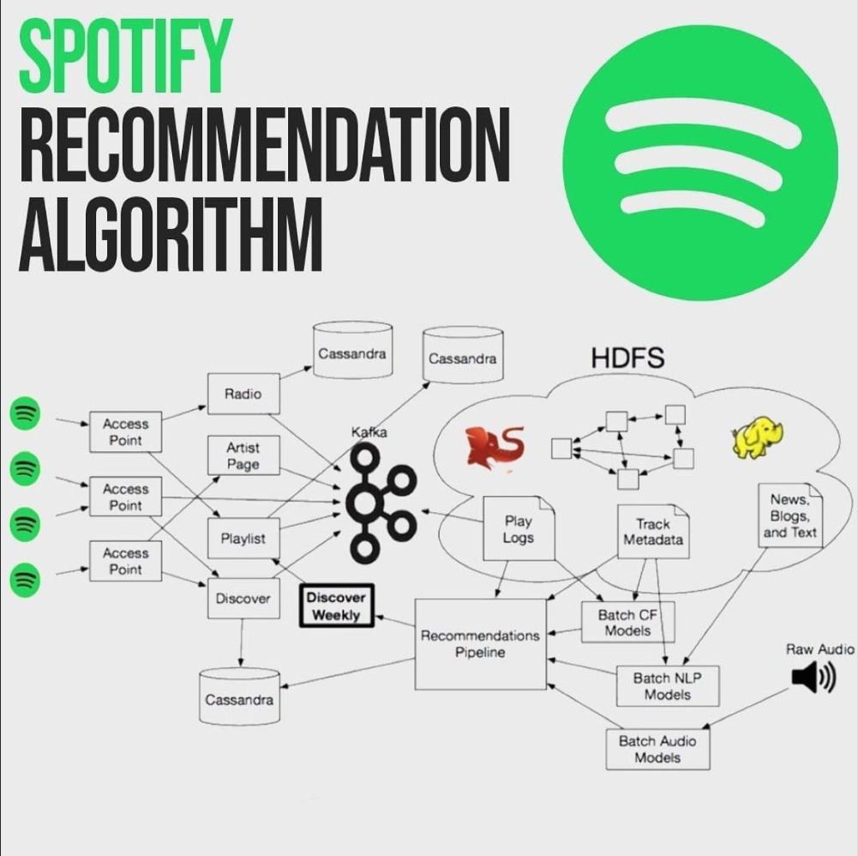
Spotify's Recommendation Techniques
Content-Based Filtering:
Audio Feature Analysis: Spotify analyzes the acoustic properties of songs, such as tempo, rhythm, and genre, to recommend similar tracks.
Metadata Analysis: It leverages metadata like artist, album, and genre to suggest related music.
Collaborative Filtering:
User-Based: Identifies users with similar listening habits and recommends music that those users have enjoyed.
Item-Based: Recommends songs or playlists that are similar to those the user has already listened to.

Slide 11

Outcomes and User Experience
Benefits for Spotify Users:
Discovery of new music tailored to individual tastes.
Personalized playlists and recommendations.
Enhanced music listening experience.
Spotify's Approach to Improving User Satisfaction:
Continuous improvement of recommendation algorithms.
Incorporation of user feedback and preferences.
Experimentation with new features and techniques.
Prioritization of user experience and satisfaction.

Slide 12
Conclusion
Content-Based Filtering:
Recommends items similar to those a user has interacted with.
Relies on item features (genre, keywords, etc.).
Example: Recommending sci-fi movies to a user who likes sci-fi.
Collaborative Filtering:
Recommends items based on similar users' preferences.
Relies on user-item interaction data (ratings, purchases, etc.).
Example: Recommending products to a user based on purchases of similar users.
Spotify's Recommendation System:
Combines content-based and collaborative filtering.
Uses audio features, metadata, and user behavior.Employs deep learning and NLP for advanced analysis.
Provides personalized recommendations, enhancing user experience.

